Slide 1



FREE MASTERCLASS
Wholesale Doru Squad Method
How To Close Your First $5K–$15K Wholesale Check In The Next 60 Days
Presented by Nasar El-arabi
“The Real Estate DORU”

Slide 2

Welcome To The Masterclass
You’re in the right room.

Slide 3

TONIGHT’S BIG PROMISE
$5K–$15K
Your First Wholesale Check In 30–60 Days
No money. No credit. No experience required.

Slide 4

WHOLESALING IS NOT DEAD
The old way is.
That’s the opportunity.

Slide 5

THE NEW LEVERAGE
AI CHANGED THE GAME
CALLS
QUALIFIES
You Close Them
WORKLOAD BECOMES SYSTEM

Slide 6
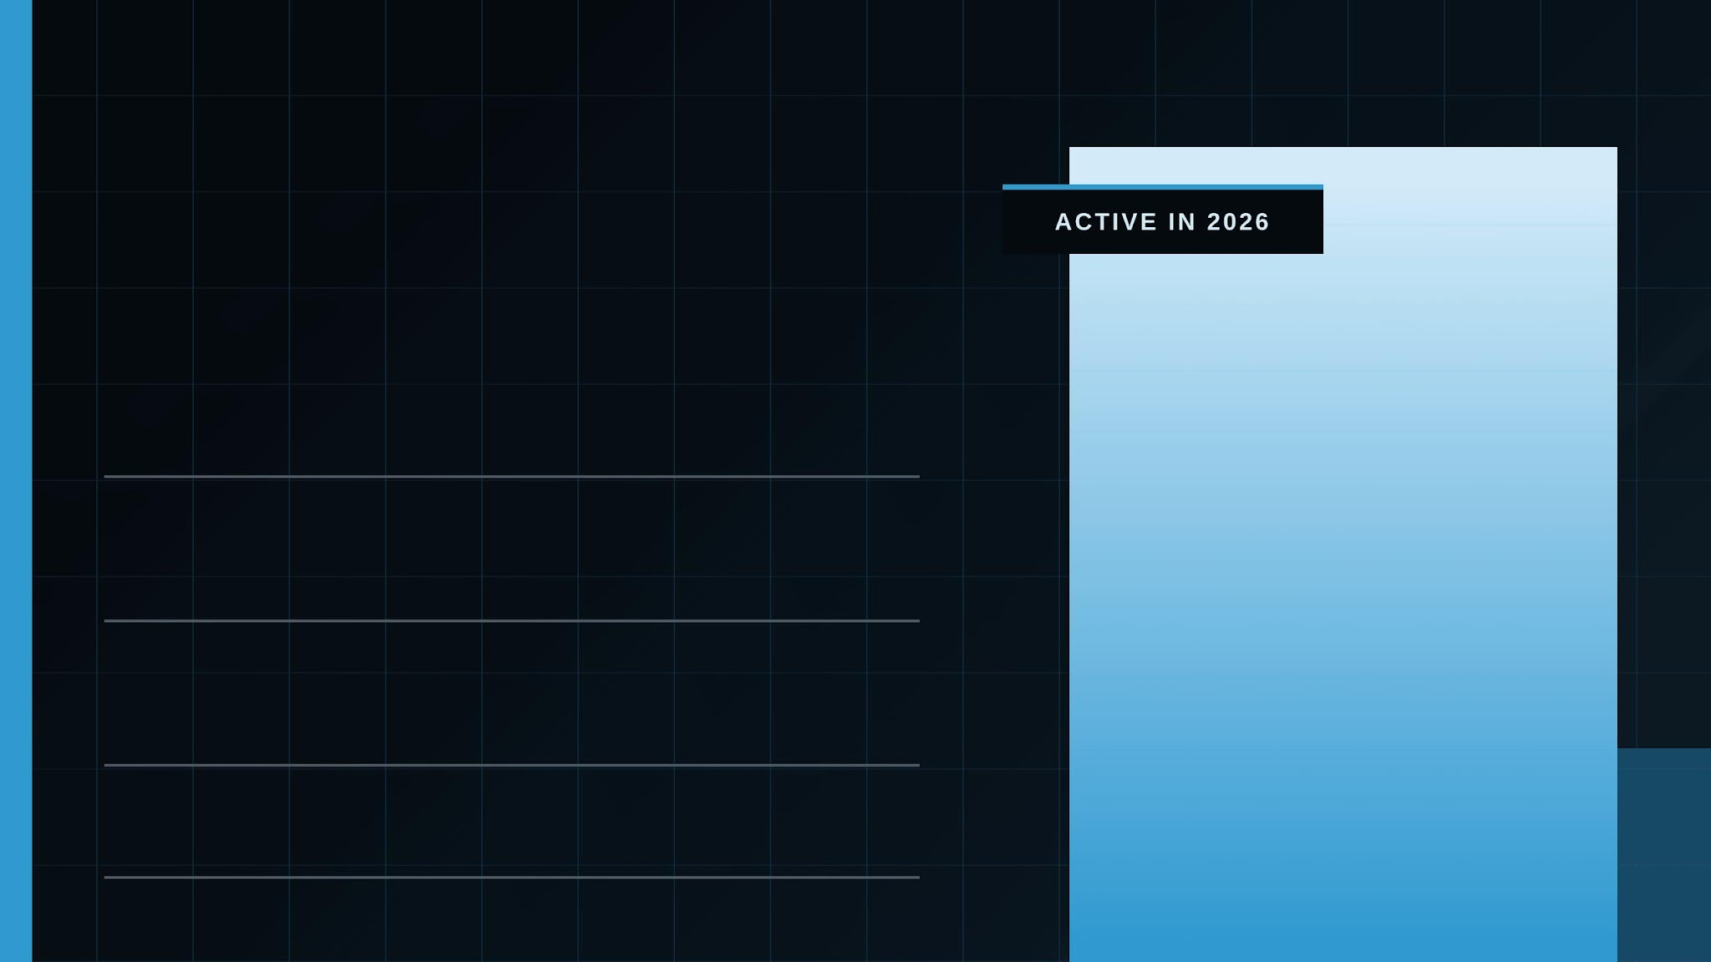


ACTIVE IN 2026
Why Listen To Nasar?
100S
OF DEALS CLOSED
7-FIG
REAL ESTATE NETWORTH
NOW
STILL ACTIVELY WHOLESALING

Slide 7
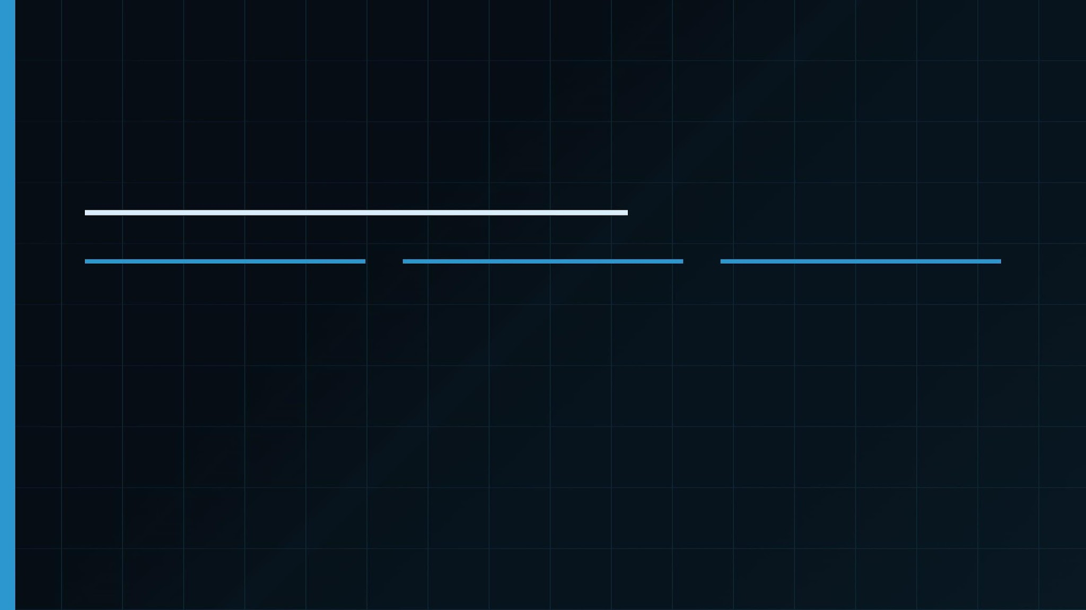
What You’ll Learn Tonight
01
02
03
Old Way vs New Way
AI Deal Qualification
No Money. No Credit.
Why traditional wholesaling slows beginners down.
How AI calls, filters, and You Close them.
The contract-control path to your first check.
WHOLESALE DORUSquad METHOD

Slide 8

Where It Started
19
A Dream
No Money
College Student
YEARS OLD
Before the deals, systems, and brand… it started with one decision.

Slide 9

$150K
BOUGHT
The $100K Wake-Up Call
$20K
REPAIRS
$270K
SOLD
One conversation made the math impossible to ignore.
$100K
PROFIT
That was Rapper Money.

Slide 10

The Decision
NASAR
EVERYONE ELSE
CHOSE
REAL ESTATE
VS
CHASED
TRENDS
One lane. One skill. One decision.
Music. Hype. The next quick thing.
Real estate became the path out.

Slide 11
Bought my 1st Fix & Flip
24
A partner & I lost 14K
Moved to Charlotte, NC with a College degree
1st Job was 10 American Dollars an Hour
YEARS OLD
2007

Slide 12

I Could Not Stop Thinking About that 100k Deal
One Deal Changed Everything
ONE REAL ESTATE DEAL
MORE
WEEK AT A JOB
One deal could beat Years of working for someone else.
$400/week

Slide 13

2011 After Getting a Coach
My First Deal Took Time
8
No shortcut. No magic button. Just reps.
MONTHS
REJECTION
CONFUSION
LEARNING CURVE

Slide 14
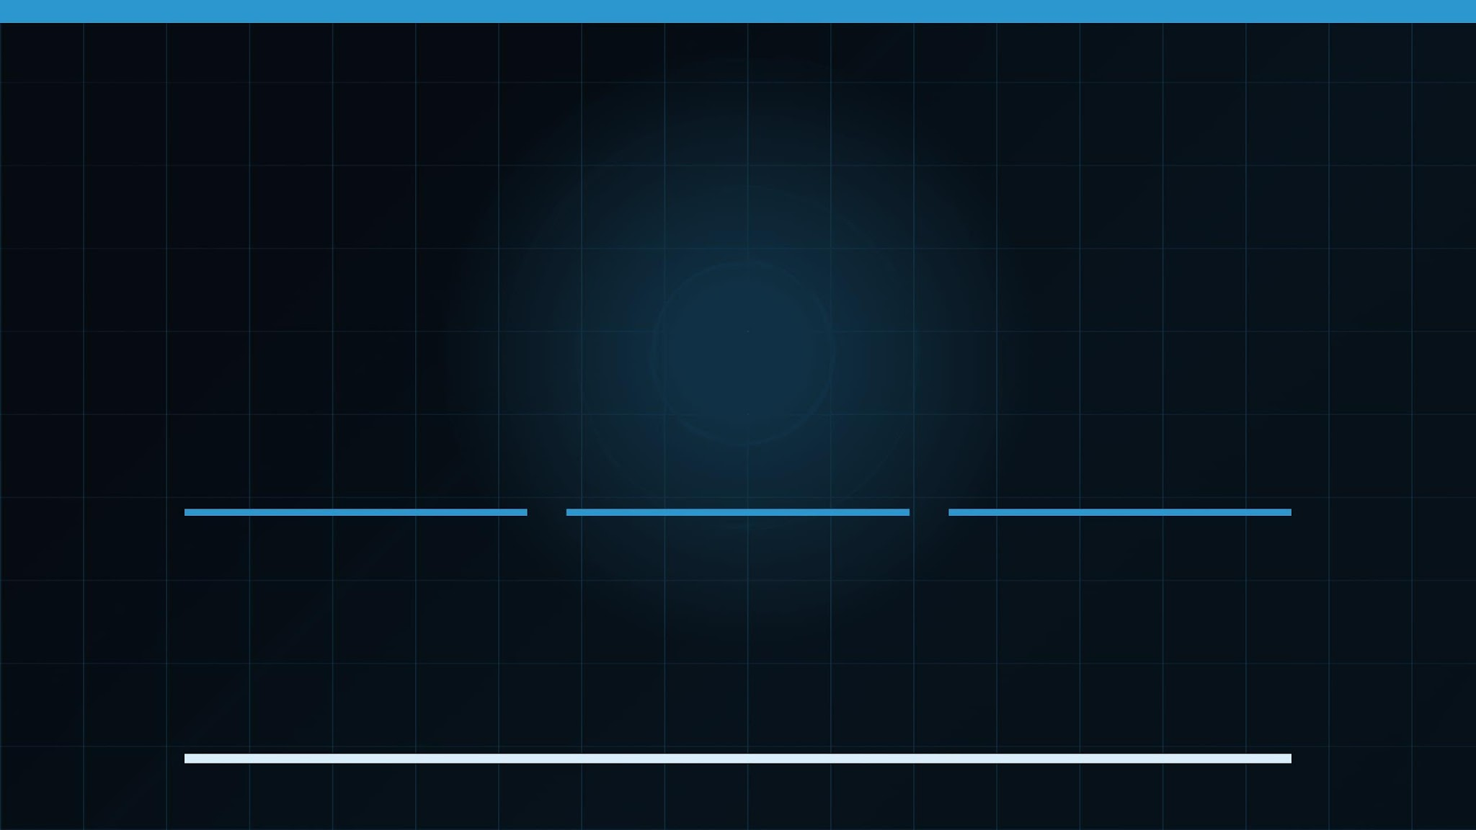
ONE DEAL CREATED BELIEF
Proof replaced doubt. Momentum started.
CONFIDENCE
MOMENTUM
PROOF
THE FIRST WIN CHANGED
ACTION BECAME EASIER
THE MODEL WAS REAL
EVERYTHING

Slide 15

My 4th Job in 4 years The Excel Lie
ROCK BOTTOM
SEPT 2012
Fired from the Job.
NO SAFETY NET
NO BACKUP PLAN
ALL IN
NOTHING TO FALL
REAL ESTATE BECAME
BACK ON
NO EASY EXIT
THE PATH

Slide 16

WHAT HAPPENED NEXT
100S
DEALS CLOSED
REAL MARKET EXPERIENCE
MULTI
INVESTING STRATEGIES
BUILT THROUGH REPETITION
The struggle became the system.
BRAND
NATIONAL RECOGNITION
THE REAL ESTATE DORU

Slide 17

What Took 8 Months…
BEFORE SYSTEMS
WITH AI SYSTEMS
8
FASTER
Months to create the first breakthrough.
Speed replaces guesswork.
LEADS
CALLS
YOU FOLLOW-UP

Slide 18

SECRET #1
THE VEHICLE CHANGED
01
The old path was manual. The new path is powered by systems.

Slide 19

THE OLD WAY
It worked… but it burned time, energy, and confidence.
01
02
03
COLD
CALLS
Direct Mail
ENDLESS
REJECTION
Strangers. Scripts. Constant resistance.
Must Spend Thousands a month
The part that makes most beginners quit.

Slide 20

THE NEW WAY
01
02
03
MOTIVATED LEADS
AI QUALIFICATION
QUALIFIED LEADS
People who already raised their hand.
Filter, score, and book the right sellers.
You only talk to Sellers who want to Sell
Speed turns intent into opportunity.

Slide 21
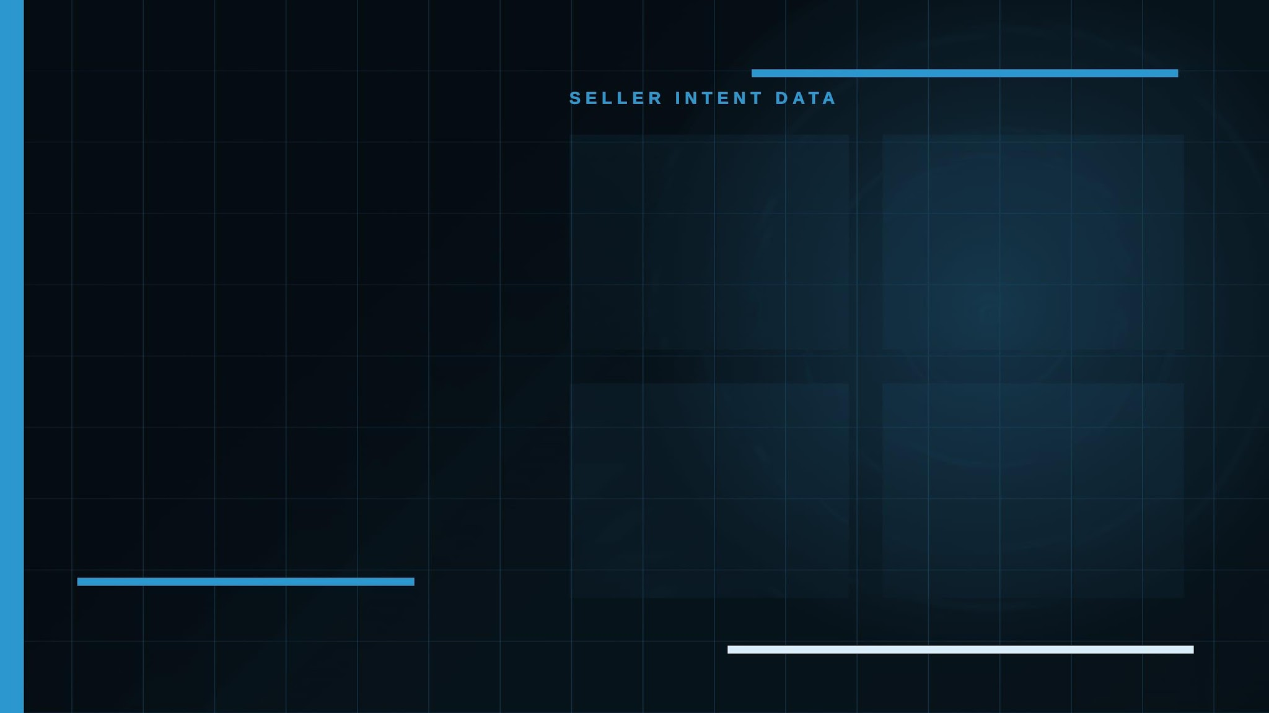
THEY ALREADY WANT TO SELL
02
01
NAME
PHONE
Who raised their hand.
How fast you can reach them.
03
04
Motivated leads arrive with the clues you need.
ADDRESS
MOTIVATION
Where the opportunity lives.
Make the DEAL Happened

Slide 22

SPEED-TO-LEAD
THE 5-MINUTE RULE
5
Speed wins before competitors even respond.
MINUTES
FIRST RESPONSE
LATE RESPONSE
CAPTURES ATTENTION
LOSES THE DEAL

Slide 23

THE BEGINNER PROBLEM
01
02
LEADS DON’T WAIT
WORKING
SLEEPING
A hot seller calls during your shift.
The lead comes in after hours.
03
04
DRIVING
BUSY
They show up when life is happening.
You can’t qualify the seller safely.
Follow-up gets pushed off again.
SPEED WINS DEALS

Slide 24

ENTER AI
01
Calls Instantly
INSTANT
Before competitors respond
AI
02
Qualifies Calmly
BAD TIMING
No nerves. No pressure.
NEVER
HESITATES
03
Get the Contract
CALL FEAR
Find the Cash Buyer

Slide 25

YOUR AI EMPLOYEE
The acquisition worker that never hesitates.
01
02
CALLS
QUALIFIES
Reaches motivated sellers instantly.
Finds motivation, timeline, and pain.
ALWAYS ON
03
AI OPERATOR
04
BOOKS
You Get Contract
Moves serious sellers to appointments.
Find Buyer
CALLS · QUALIFIES · BOOKS · FOLLOWS UP

Slide 26

LAST 90 DAYS
REAL BUSINESS NUMBERS
47
Deals Contracted
In the last 90 days
AI handles the front end.
Nasar focuses on the highest-value conversations.
8
Seller Conversations
Personally handled by Nasar

Slide 27

SECRET #2
THE INTERNAL GAME
02
MONEY , CREDIT, SALES FEAR
Remove the beliefs that stop beginners before they start.

Slide 28

SECRET #2 · BELIEF
THE REAL PROBLEM
01
“I DON’T KNOW ENOUGH”
IT IS NOT
LEADS
02
“I’M NOT READY”
IT IS BELIEF UNDER PRESSURE.
Most beginners don’t think they can actually do this.
03
“WHAT IF I FAIL?”

Slide 29

THE TRUTH
WHOLESALING CONTROLS
“I NEED MONEY TO START”
CONTRACTS
NOT HOUSES
That is buying-house thinking.
LOCK IT UP
ASSIGN IT
COLLECT FEE
CONTROL THE DEAL
BRING THE BUYER
NO MORTGAGE
NEEDED

Slide 30

HOW WHOLESALING WORKS
You control the opportunity before you ever buy the house.
03
04
01
02
ASSIGN CONTRACT
COLLECT FEE
LOCK IT UP
FIND BUYER
Get the property under contract.
Bring the investor who wants the deal.
Transfer your rights to the buyer.
Get paid for creating the opportunity.
Control the deal. Assign the contract. Collect the spread.

Slide 31

THE MECHANISM
YOU CONTROL THE CONTRACT
“MY CREDIT IS BAD”
ASSIGNMENT DEALS
NO CREDIT CHECK
01
Find Seller
That matters when you borrow. Not when you assign.
Motivated situation
NOBODY IS LENDING TO YOU.
02
Assign Deal
Buyer brings funding
03
Collect Fee
Credit stays irrelevant

Slide 32

“I HATE The Phones”
AI
HANDLES THE FIRST CONVERSATION
BEFORE YOU EVER SPEAK TO THE
SELLER
01
02
03
Good. You do not need to start with pressure.
ASKS
QUALIFIES
You Close Them
Motivation, timeline, condition, price.
Filters serious sellers from noise.
Moves the right lead to the next step.

Slide 33

AI DOESN’T GET NERVOUS
PEOPLE HESITATE
ALWAYS ON
FEAR
AI
It calls, qualifies, and follows up without emotional resistance.
PROCRASTINATION
NO NERVES
MISSED FOLLOW-UP
CALLS
QUALIFIES
You CLOSE Them
INSTANTLY
CALMLY
CONSISTENTLY Close

Slide 34

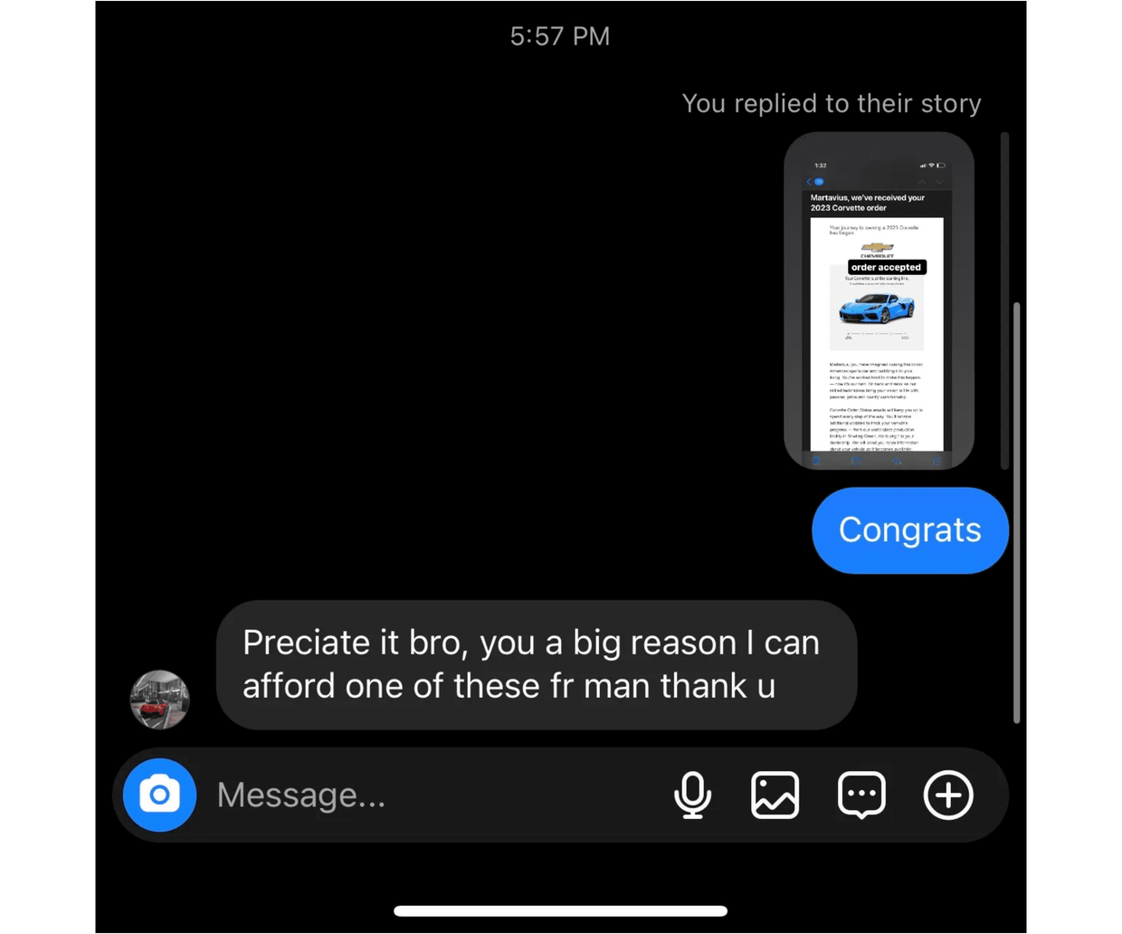
SCREENSHOT PROOF
STUDENT PROOF
REAL STUDENT WIN
“You’re a big reason I can afford one of these.”
CLEAR PROOF
SECRET #2 · BELIEF SHIFT

Slide 35

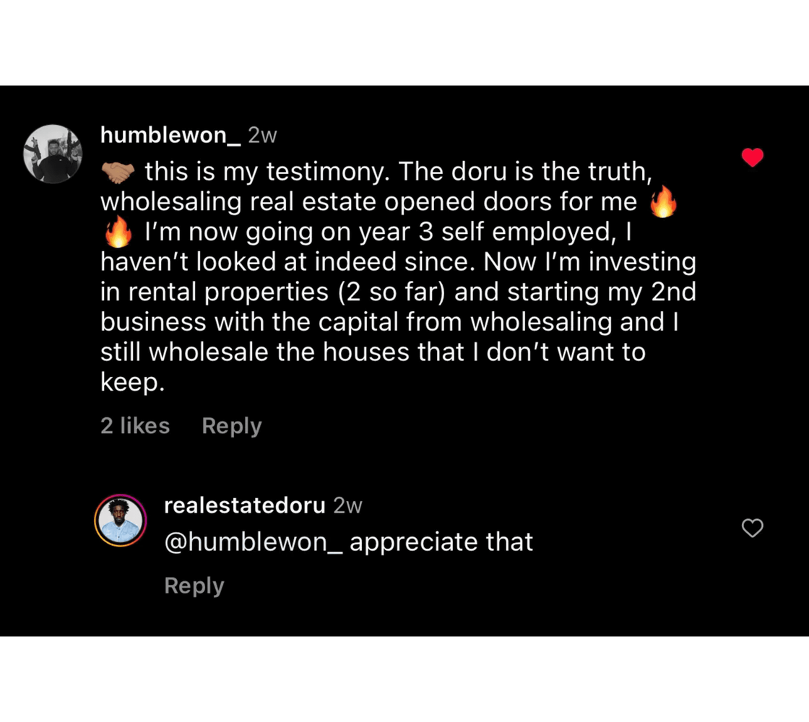
REAL TESTIMONIAL
STUDENT PROOF
YEAR 3 SELF-EMPLOYED
NO INDEED
RENTAL PROPERTIES
SECOND BUSINESS
THE DORU IS THE TRUTH

Slide 36

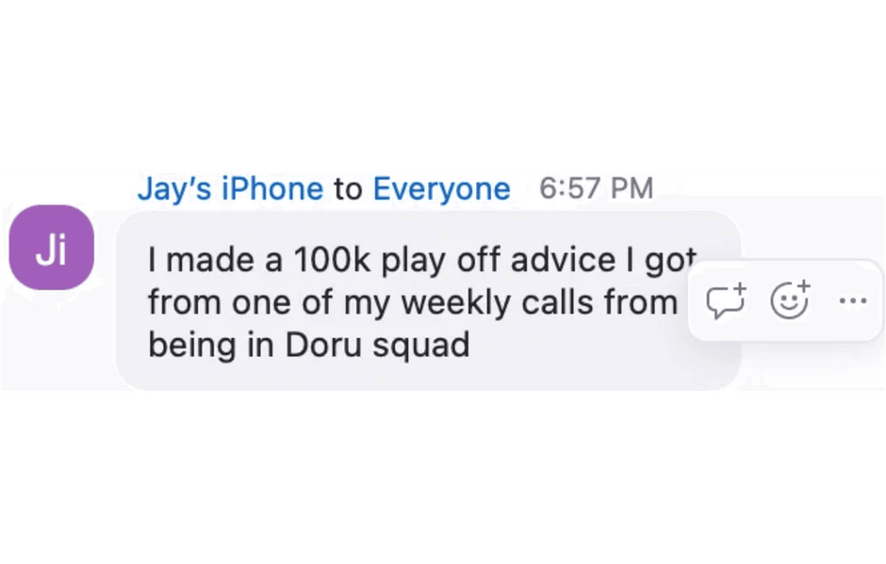
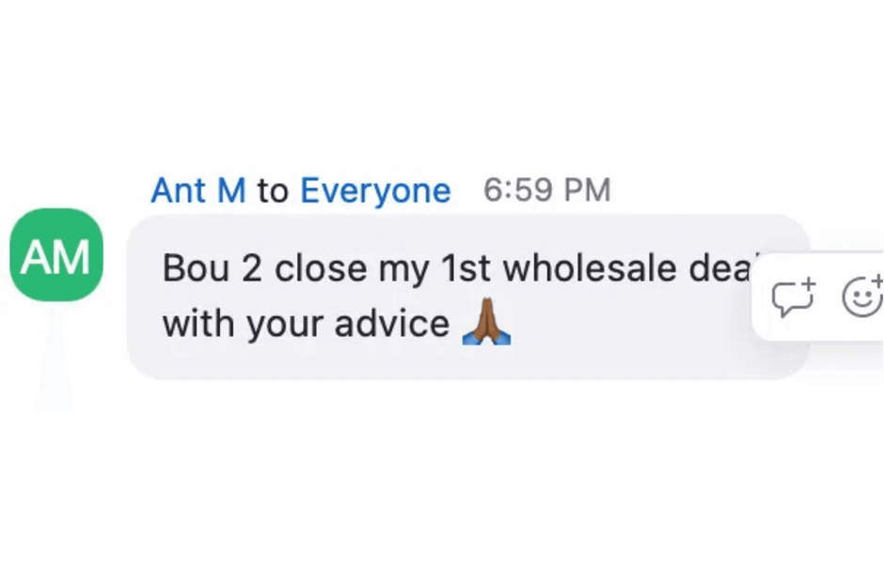
MORE PROOF
STUDENT WINS
$100K PLAY
FIRST DEAL
REAL MESSAGES · REAL MOMENTUM

Slide 37

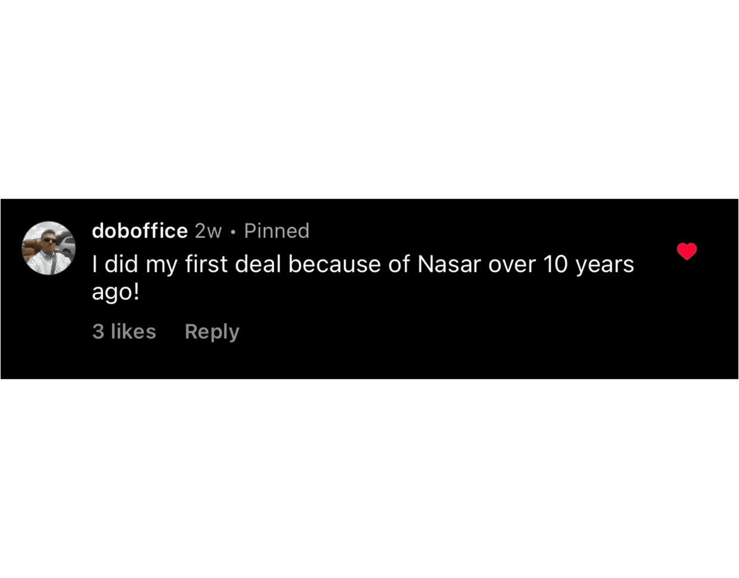
PROOF
STUDENT PROOF
10+ YEAR IMPACT
First deal because of Nasar.
LONG-TERM TRUST
REAL STUDENTS · REAL HISTORY

Slide 38

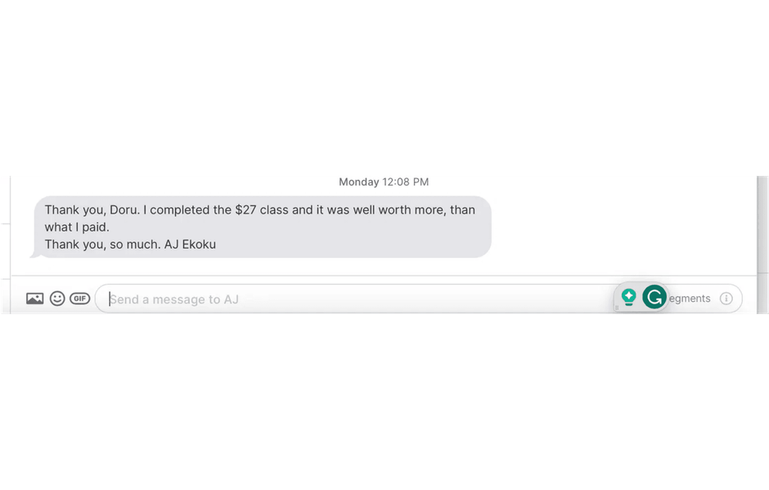
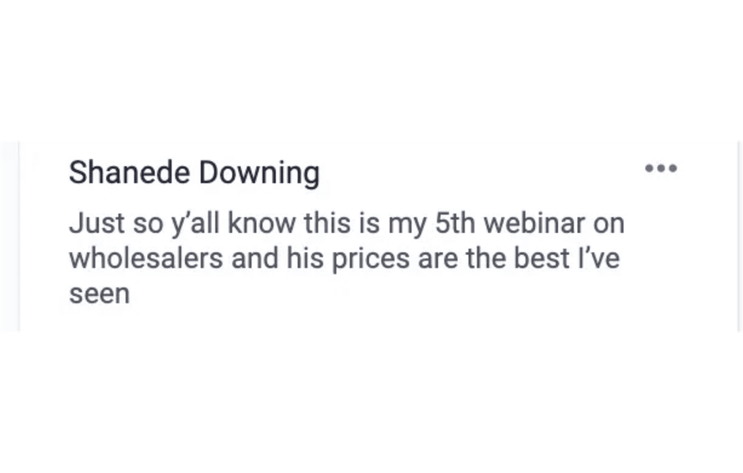
TRUST PROOF
VALUE CONFIRMED
WORTH MORE
BEST PRICE SEEN
LOW RISK · HIGH TRUST

Slide 39

WHAT YOU LEARN
CONFIDENCE COMES FROM REPS
01
What To Say
When sellers hesitate
02
How To Respond
Without freezing up
Listen back.
Learn the patterns.
03
When To Move
From lead to Opportunity

Slide 40

SECRET #3
THE MARKET OPPORTUNITY
03
Motivation is everywhere.
AI helps you find it faster.
OPPORTUNITY MAP
PROBATE
HIDDEN
FORECLOSURE
URGENT
INHERITANCE
READY

Slide 41

SECRET #3
MOTIVATION IS EVERYWHERE
DIVORCE
PROBATE
FORECLOSURE

Slide 42

DISTRESS CREATES DEALS
TIME
PAIN
PRESSURE

Slide 43

TIRED LANDLORDS
HIDDEN MARKETS
INHERITED HOMES
VACANT PROPERTY

Slide 44

AI GIVES YOU SCALE
SPEED
Get More Done
COVERAGE

Slide 45

LIVE DEMO
WATCH THE AI WORK

Slide 46

DEMO FLOW
IMPORT
CALL
TAG
ANALYZE

Slide 47

SYSTEMS
THIS IS THE FUTURE
AI
ACQUISITION

Slide 48

TWO CHOICES
OR
ALONE
SYSTEM
CHOOSE THE SYSTEM

Slide 49

THE WHOLESALE DORU SQUAD MENTORSHIP
COACHING
AI OS
DEAL REVIEWS
COMMUNITY

Slide 50
THE D.O.R.U. METHOD
The exact system the Squad runs — start to check.
R
U
D
O
READY SELLERS
UNDER CONTRACT
DATA
OPERATOR
Motivated sellers raise their hand.
Your AI calls and qualifies instantly.
You only talk to people who want out.
Lock it up, assign it, collect your fee.
Data. Operator. Ready sellers. Under contract.

Slide 51

WHAT YOU GET
FULL TRAINING
THE AI OS
DEAL REVIEWS
SCRIPT VAULT

Slide 52

THIS ISN’T A COURSE.
IT’S A PARTNERSHIP.
PROXIMITY
SYSTEMS
SUPPORT
SPEED

Slide 53
YOU’RE NEVER ON YOUR OWN
Every contract gets reviewed.
Every question gets answered.

Slide 54

LET’S BE DIRECT
THE COST
FINANCING
4-FIGURE
OPTIONS
APPLY
TONIGHT

Slide 55
Illustration, not a promise. Deals require work.
The Math On One Deal
ONE ASSIGNMENT FEE
$5K–$15K
THE MENTORSHIP
One deal can cover the entire investment.
One-time

Slide 56
THE QUESTION ISN’T THE PRICE
It’s what another year of waiting costs.
You already know what staying stuck feels like.

Slide 57

NEXT STEPS
Apply. Talk. Decide. No pressure. No tricks.
Apply
Book A Call
Decide
01
2-minute application
02
A real talk about
03
If it’s a fit, we build
.
your market.
.

Slide 58
NOT A FIT? WE’LL SAY NO
The call is a conversation, not a pressure session.
We only win when you close deals.

Slide 59
10 NEW MEMBERS A MONTH. MAX
Deal reviews and coaching are real work — not scarcity theater.
When the month is full, it’s full.

Slide 60
THE ANSWER
IT IS A
“WHAT’S THE INVESTMENT?”
4-FIGURE
INVESTMENT
A fair question. Here is the honest answer.
EXACT NUMBER
FINANCING
NO SURPRISES
COVERED ON YOUR CALL
AVAILABLE IF ACCEPTED
NO PRESSURE
EVER

Slide 61
“I DON’T Have Time”
AI
WORKS WHILE YOU ARE
AT WORK, ASLEEP, OR WITH
FAMILY
01
02
03
Good news. The system was built for busy people.
AI CALLS
YOU REVIEW
You Close
Leads get worked all day, every day.
Check qualified sellers on your schedule.
A few focused hours a week.

Slide 62
90 DAYS FROM NOW
PICTURE IT
Your AI calling. Your first contract in motion.
Or exactly where you are right now. Your call.

Slide 63
TYPE “APPLY”
IF YOU WANT AN INVITE

Slide 64
APPLY NOW
NAS-DEAL-APPLY.PAGES.DEV

